Slide 1
Pacific blue marlin catch and size data from RFMOs
Catch: longline - WCPFC + IATTC; purse seine- IATTC
Size: purse seine - IATTC

Slide 2
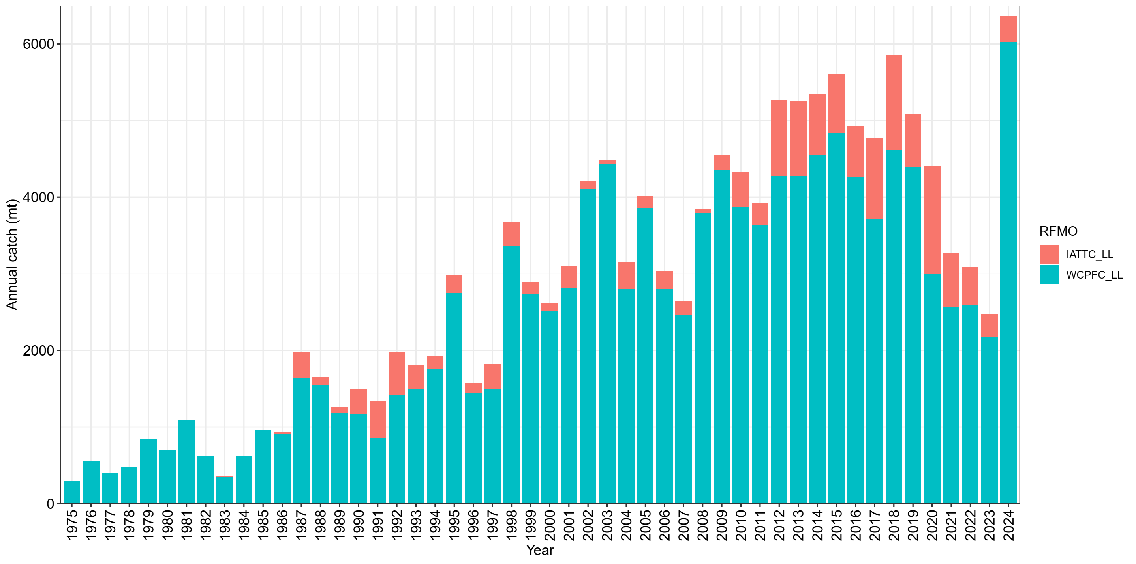
Historical longline catches of BUM by RFMOs
Remove the catch from the US, Taiwan, and Japan;
Remove catches from the overlap area in the IATTC dataset;

Slide 3
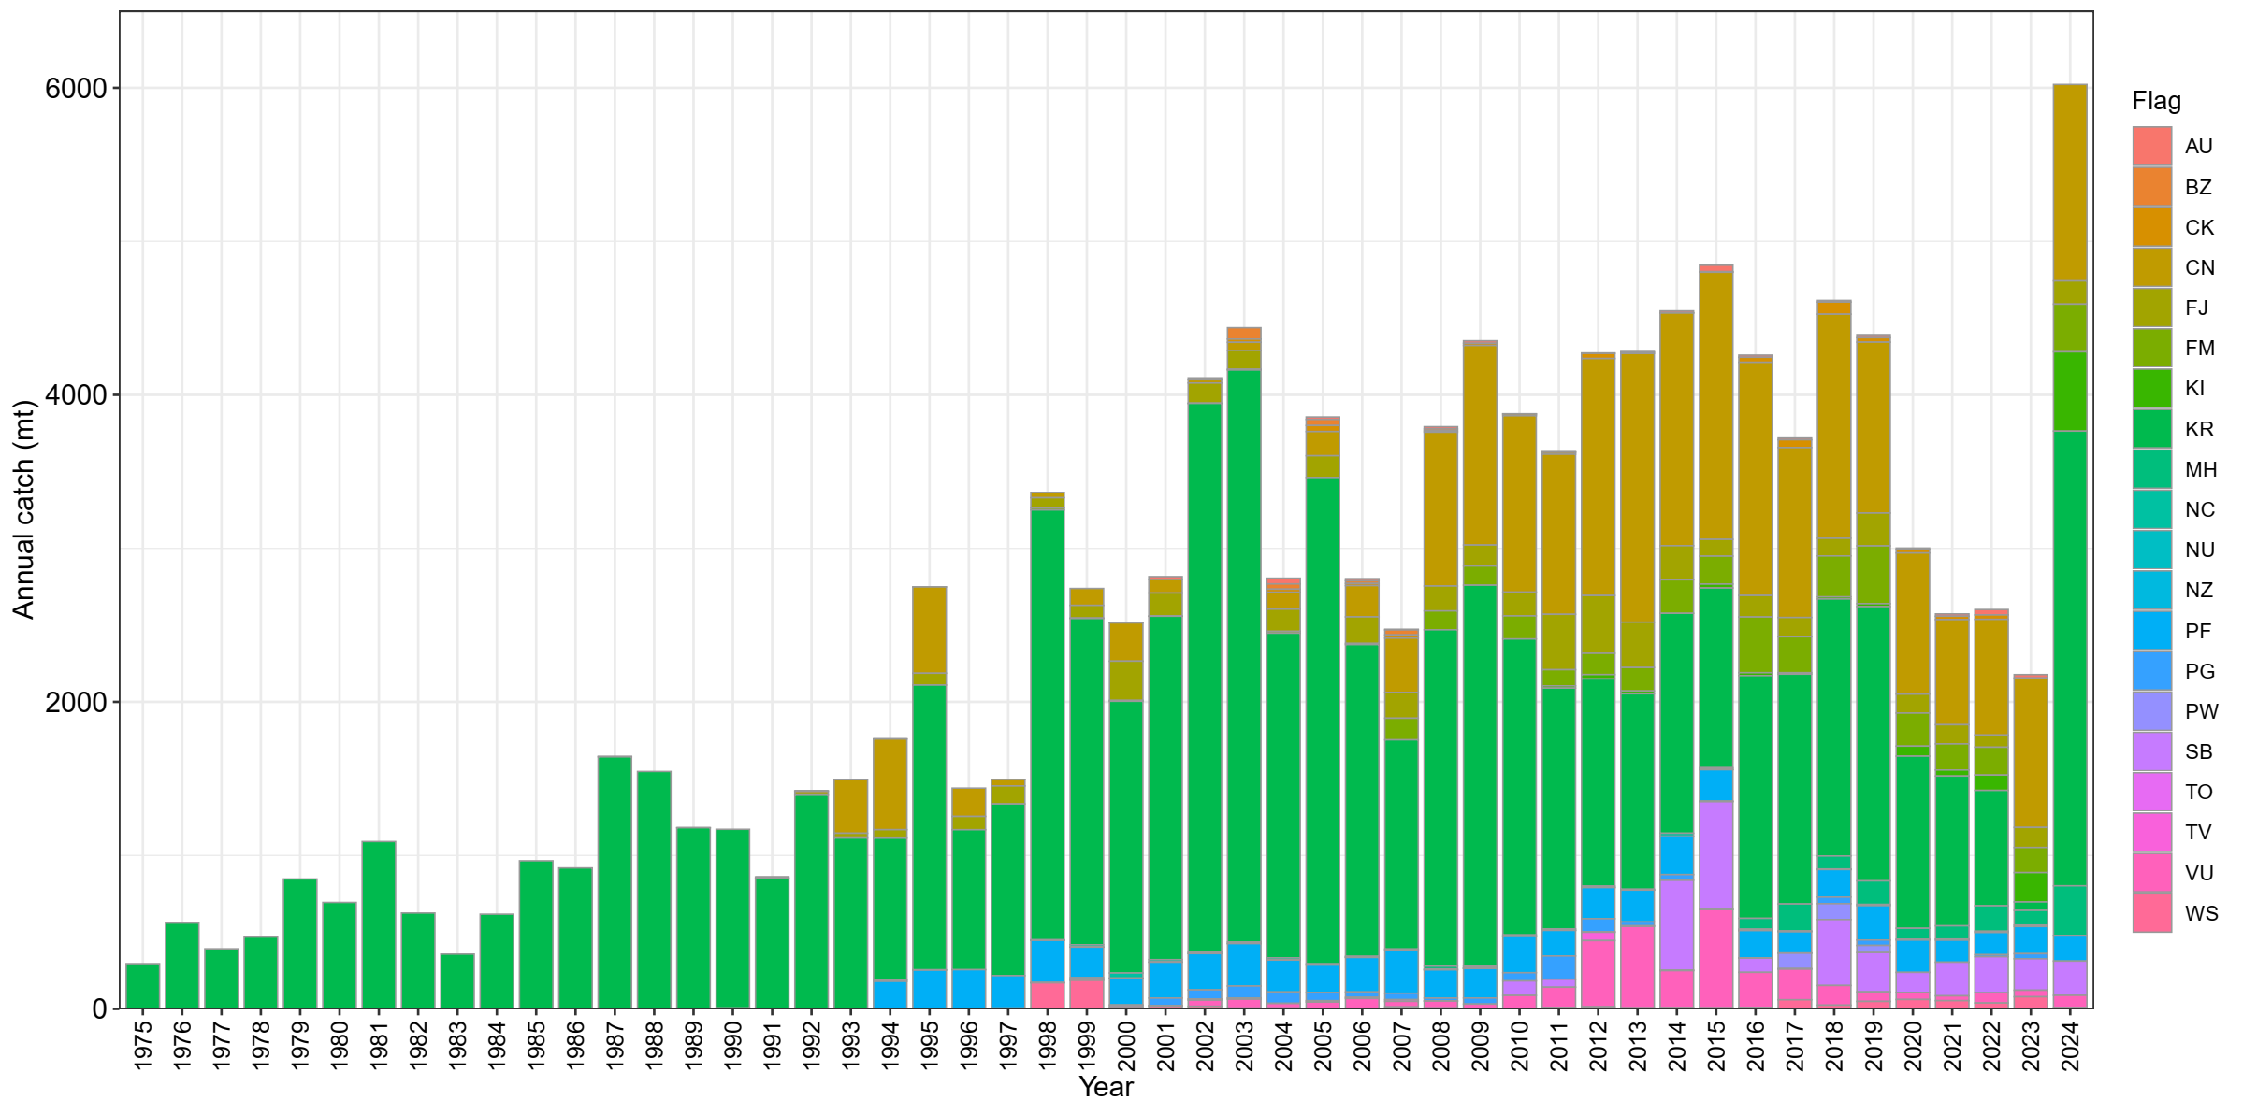
Historical longline catches of BUM in WCPFC by flags
Remove the catch from the US, Taiwan, and Japan;
Remove catches from the overlap area in the IATTC dataset;

Slide 4
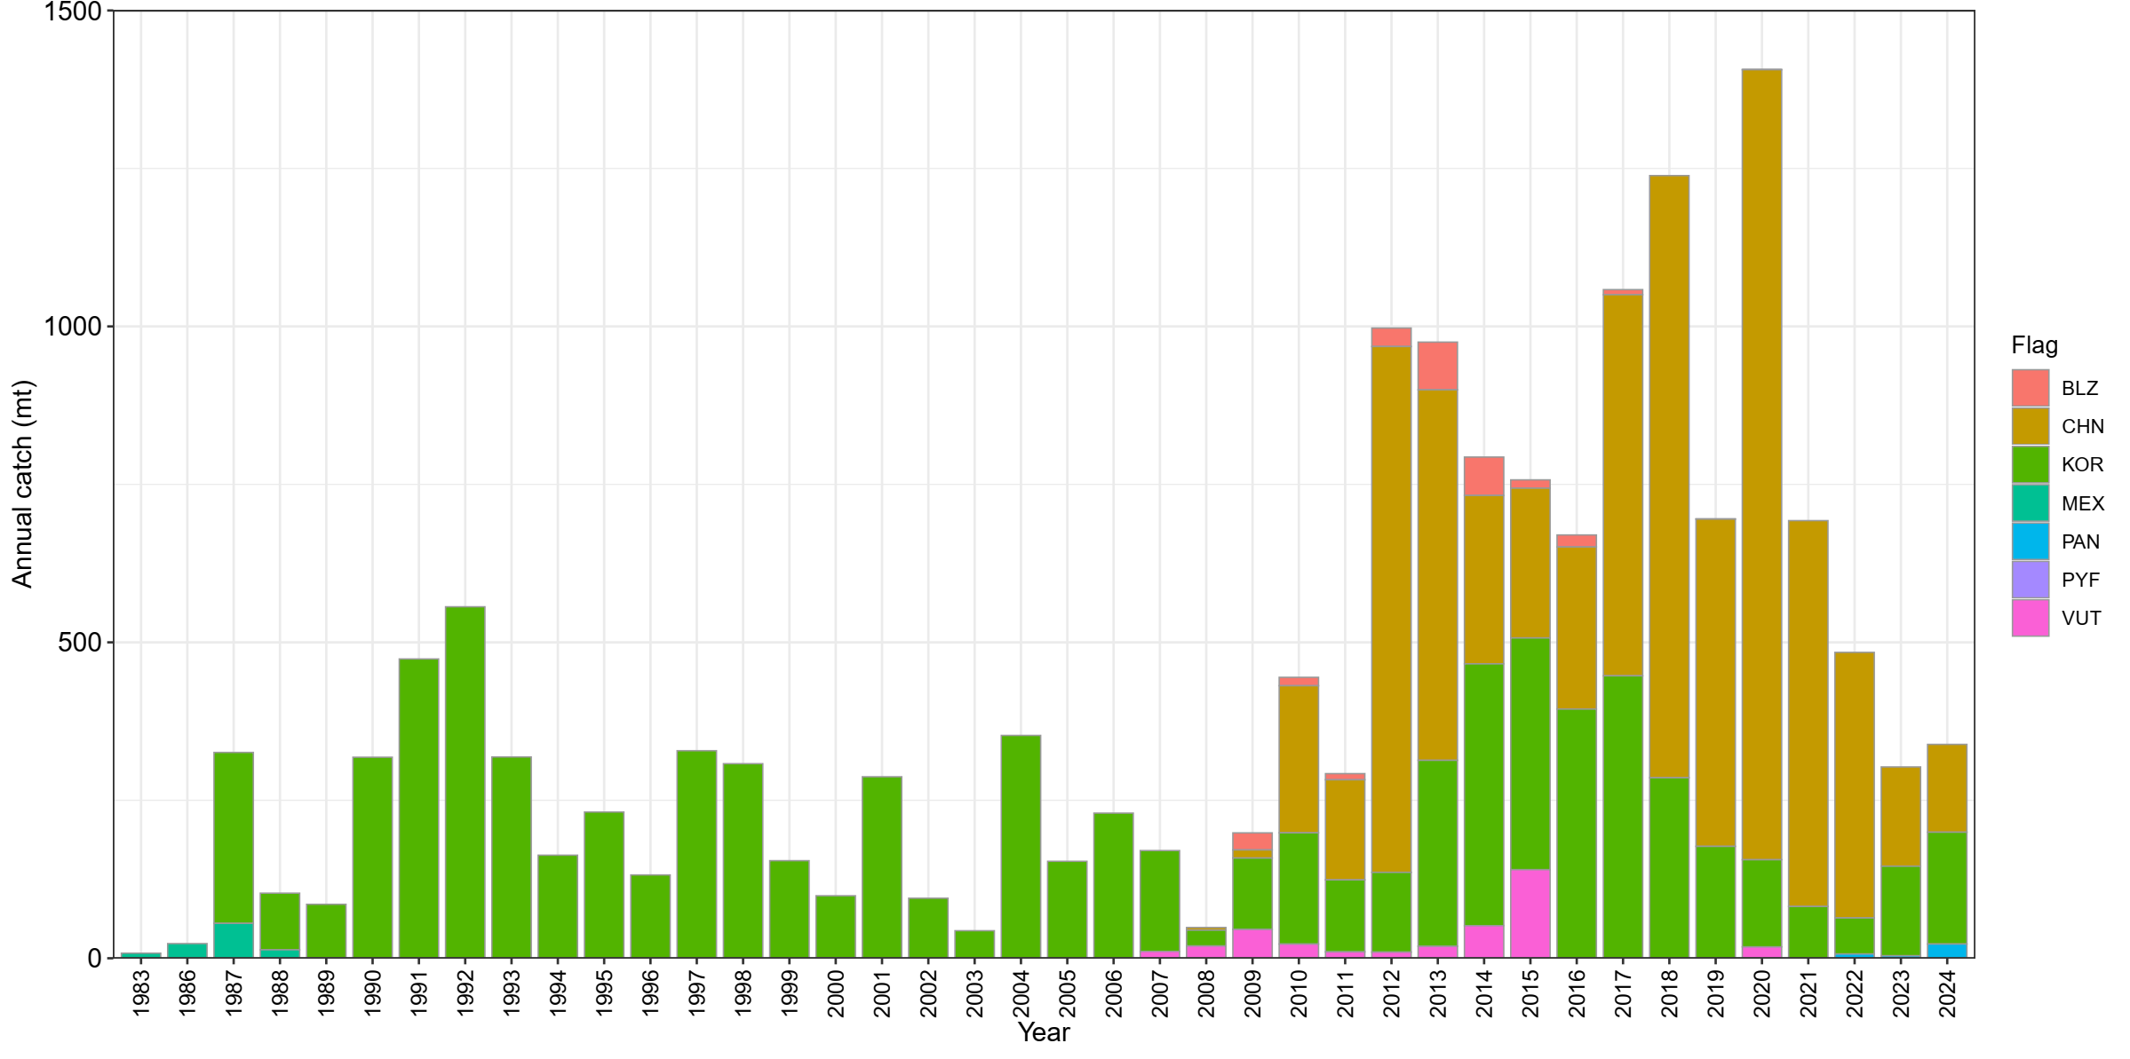
Historical longline catches of BUM in IATTC by flags
* Remove the catch from the US, Taiwan, and Japan

Slide 5
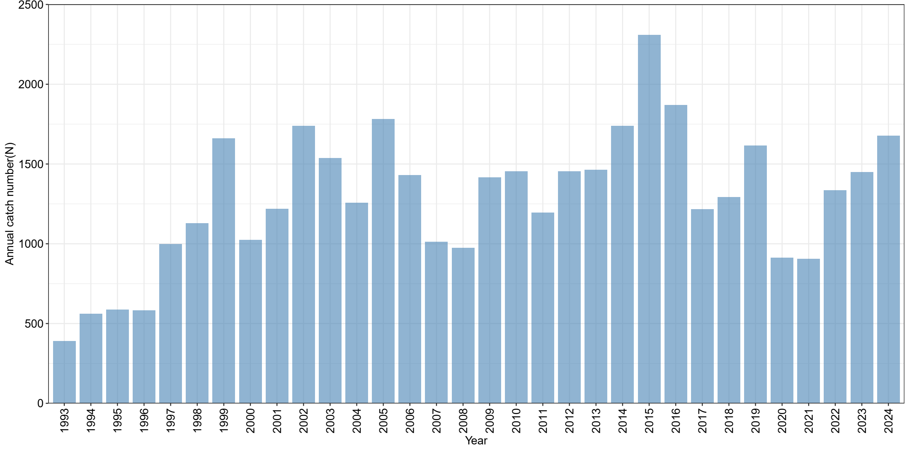
Historical purse seine catches of BUM in IATTC
* Remove the catch from the US, Taiwan, and Japan

Slide 6
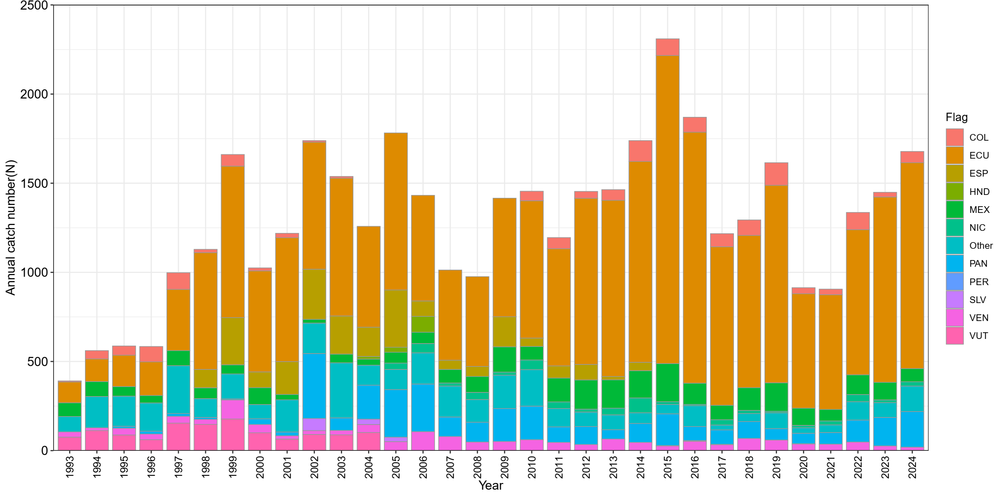
Historical purse seine catches of BUM in IATTC by flags
* Remove the catch from the US, Taiwan, and Japan

Slide 7
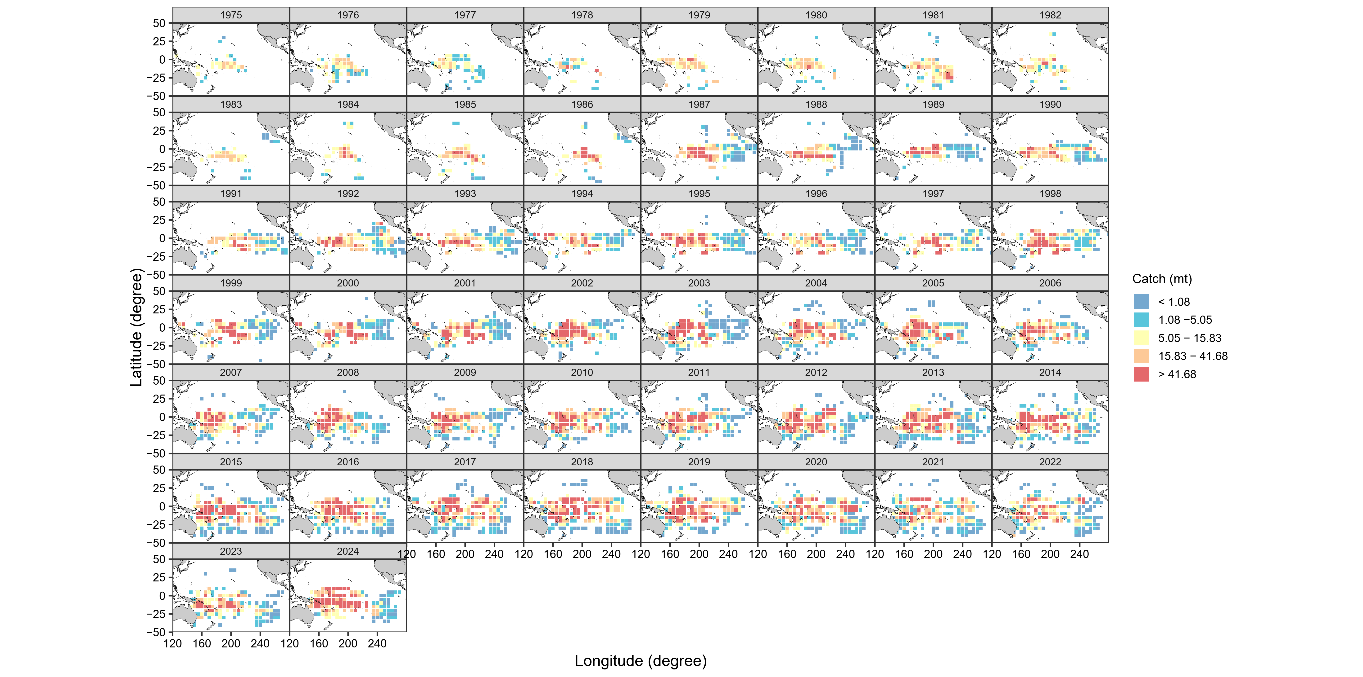
Maps of BUM longline catch in the Pacific for both RFMOs
Remove the catch from the US, Taiwan, and Japan;
Remove catches from the overlap area in the IATTC dataset;

Slide 8
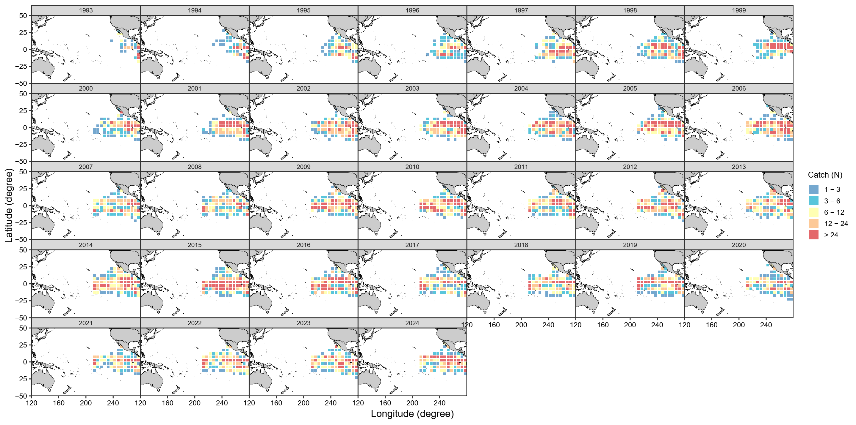
Maps of BUM purse seine catch in IATTC area

Slide 9
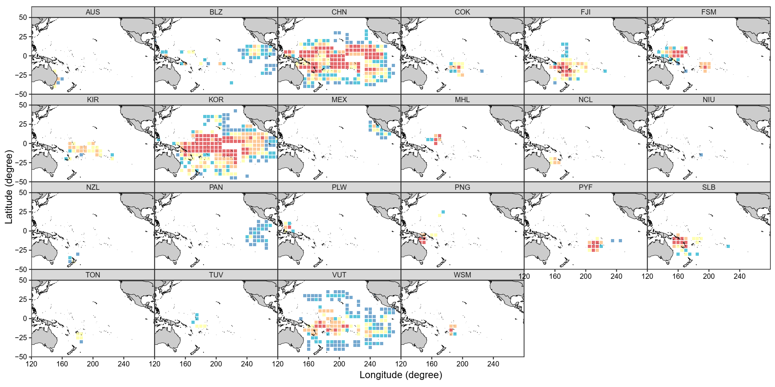
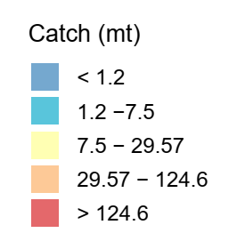
Maps of BUM longline catch in the Pacific for both RFMOs by flags

Slide 10
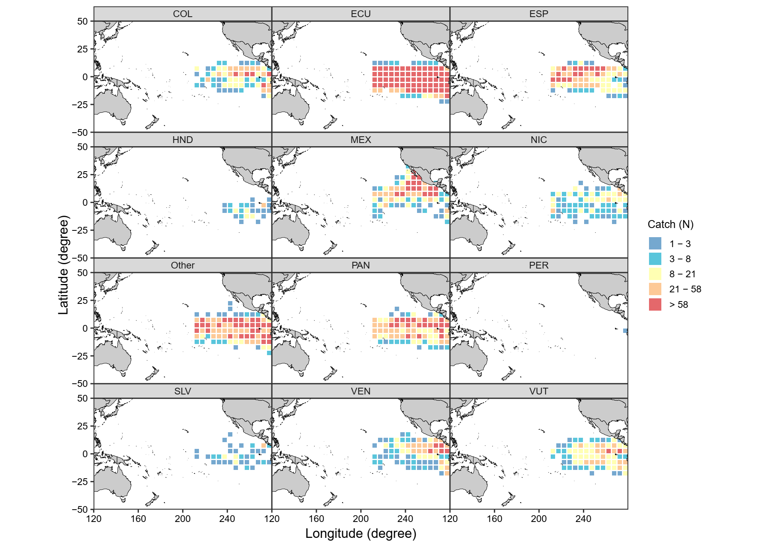
Maps of BUM purse seine catch in the Pacific in IATTC area by flags

Slide 11
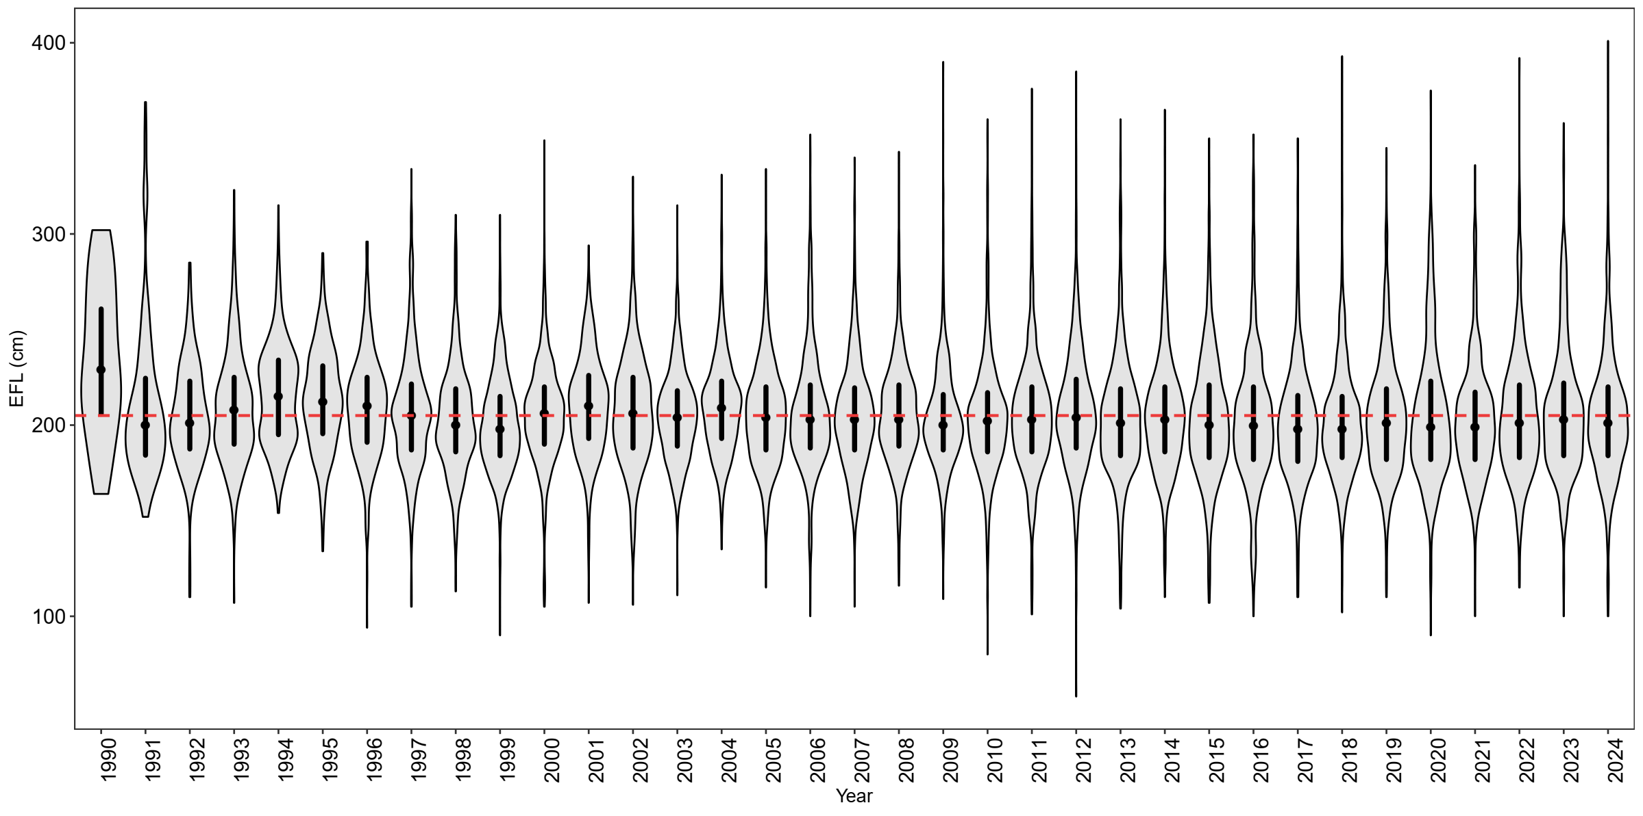
BUM size data from observer purse-seine data in the EPO

